Slide 1

Experience Report: System Log Analysis for Anomaly Detection
Shilin He, Jieming Zhu, Pinjia He, and Michael R. Lyu
Department of Computer Science and Engineering,
The Chinese University of Hong Kong, Hong Kong
2016/10/26

Slide 2
Outline
Background & Motivation
Framework
Supervised Anomaly Detection
Unsupervised Anomaly Detection
Evaluation
Conclusion
2

Slide 3
Outline
Background & Motivation
Framework
Supervised Anomaly Detection
Unsupervised Anomaly Detection
Evaluation
Conclusion

Slide 4


Background
Operating systems, software frameworks, distributed systems, etc.

Slide 5






Background
Especially, many online services and applications are deployed on distributed systems.
…

Slide 6




Background
System breakdown causes significant revenue loss.
System
Failures
Anomaly detection could pinpoint issues promptly and help resolve them immediately.

Slide 7
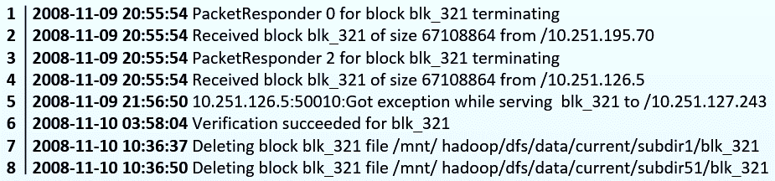
Background
Logs :
Logs are the main data source for system anomaly detection.
Logs are routinely generated by systems (e.g., 24 x 7 basis).
Logs record detailed runtime information, e.g., timestamp, state, IP address.

Slide 8

Background
Manual inspection of logs becomes impossible!
Check logs manually? Oh, NO!
Systems are often implemented by hundreds of developers.
Logs are generated at a high rate & Noisy data are hard to distinguish.
Systems generate duplicated logs due to fault tolerant mechanism.
Many automated log-based anomaly detection methods are proposed!

Slide 9
Background
Log-based anomaly detection methods:
Failure diagnosis using decision trees [ICAC’04]
Failure prediction in IBM bluegene/l event logs [ICDM’07]
Detecting largescale system problems by mining console logs [SOSP’09]
Mining invariants from console logs for system problem detection. [USENIX ATC’10]
Log Clustering based Problem Identification for Online Service Systems [ICSE’16]
…

Slide 10
Outline
Background & Motivation
Framework
Supervised Anomaly Detection
Unsupervised Anomaly Detection
Evaluation
Conclusion

Slide 11

Motivation
Developers are not aware of the state-of-the-art log-based anomaly detection methods.
No open-source tools are currently available.
Lack of comparison among existing anomaly detection methods.
Academia
Industry

Slide 12
Outline
Background & Motivation
Framework
Supervised Anomaly Detection
Unsupervised Anomaly Detection
Evaluation
Conclusion

Slide 13
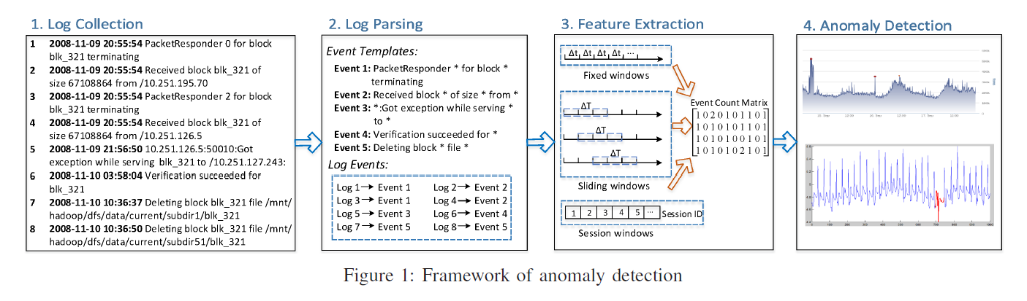
Framework

Slide 14

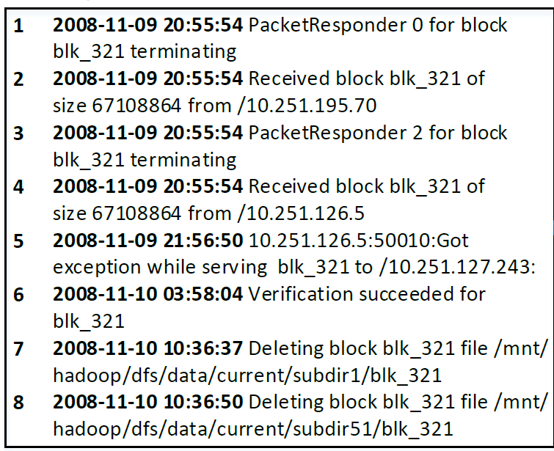
1. Log Collection

Slide 15
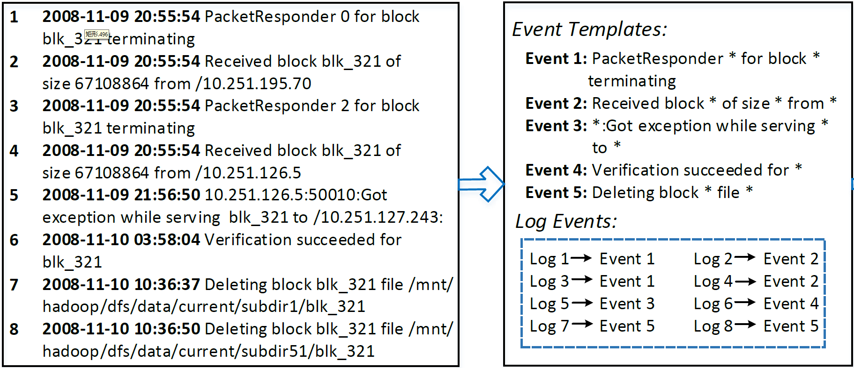


2. Log Parsing

Slide 16
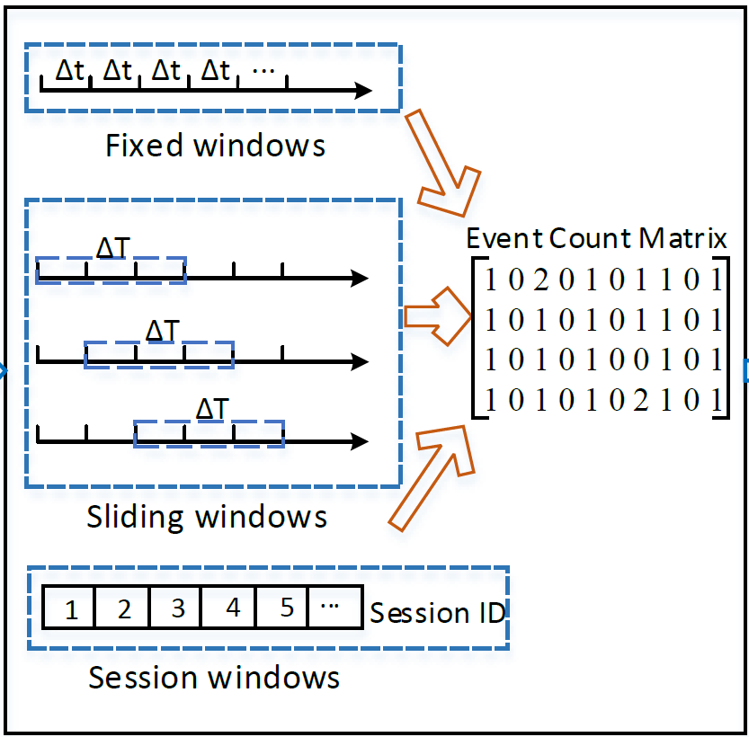
3. Feature Extraction
Divide all logs into different log sequences (windows)
log sequence <=> row in the event count matrix.
Windows | Basis
Fixed windows | Time
Sliding windows | Time
Session windows | Identifiers

Slide 17

4. Anomaly Detection
Anomaly detection methods
Supervised
Unsupervised
Logistic Regression
Decision Tree
Support Vector Machine
Log Clustering
PCA
Invariants Mining

Slide 18
Outline
Background & Motivation
Framework
Supervised Anomaly Detection
Unsupervised Anomaly Detection
Evaluation
Conclusion

Slide 19
Supervised Anomaly Detection
Logistic Regression
Decision Tree
Support Vector Machine (SVM)
Build model with training data
Apply model on testing data
Measure performance
General procedure:
Training
Testing
All data

Slide 20
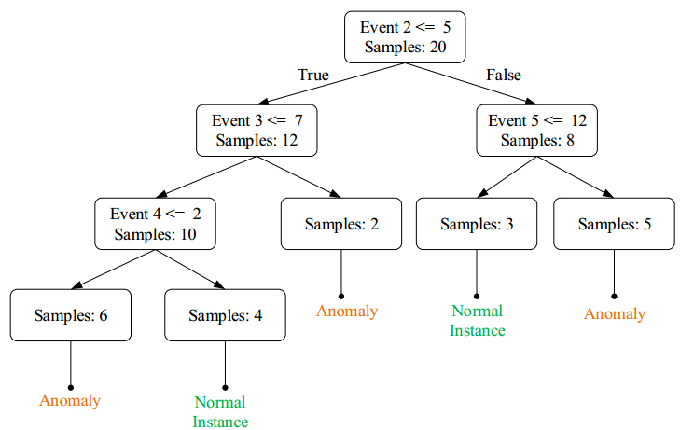

Supervised Anomaly Detection
Trained Decision Tree Example:
Anomaly

Slide 21
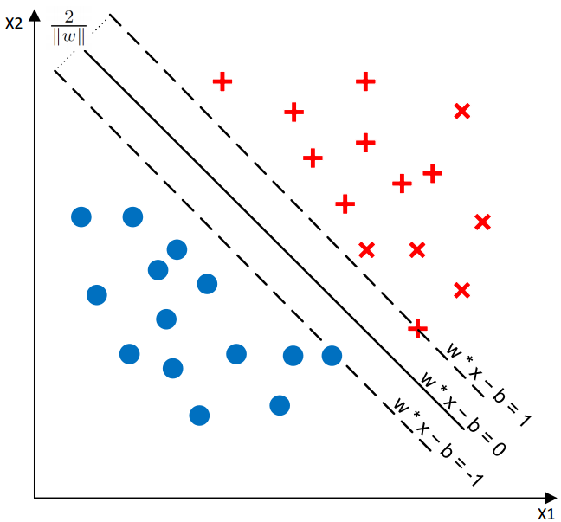
Supervised Anomaly Detection
Trained SVM Example:
Anomalies
Normal instances

Slide 22
Outline
Background & Motivation
Framework
Supervised Anomaly Detection
Unsupervised Anomaly Detection
Evaluation
Conclusion

Slide 23
Log Clustering
Update representatives
Distance (new instance, representatives)
Add into cluster
Detection
Online learning
Knowledge base initialization
Log vectorization
Representative extraction
Log clustering

Slide 24
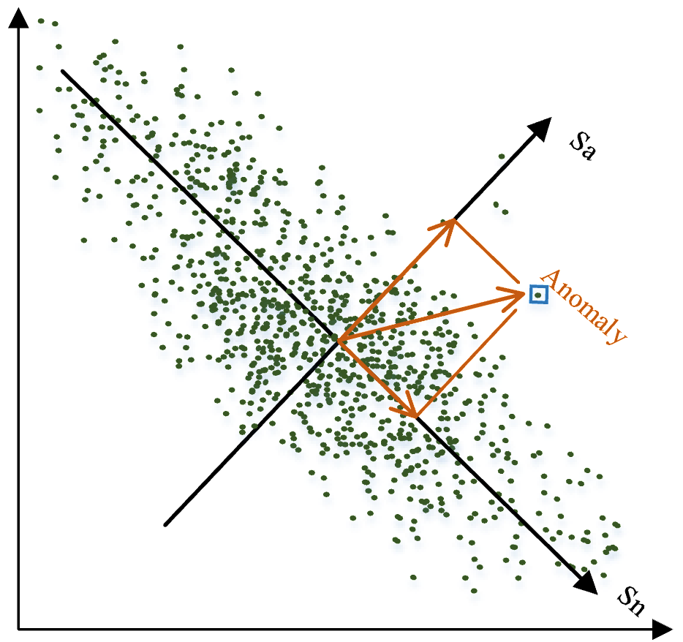
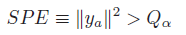
PCA
Two subspaces are generated by PCA:
Sn: Normal Space, constructed by first k principal components.
Sa: Anomaly Space, constructed by remaining (n-k) components.
Project y into anomaly space using
where P is the vector of first k principal components.
An event count vector is regarded as anomaly if
Q is the threshold
Notes:
Squared prediction error

Slide 25
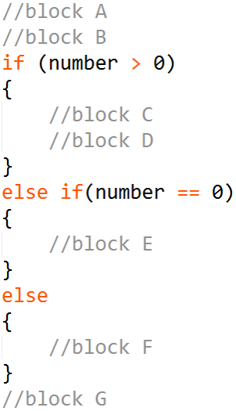
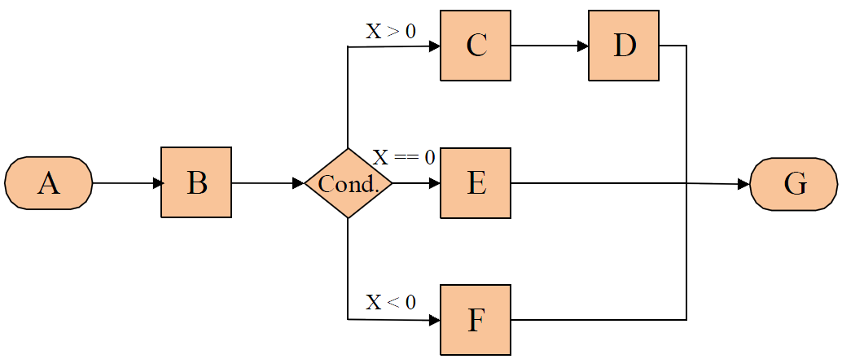
Invariants Mining
Code:
Program Execution Flow:

Slide 26
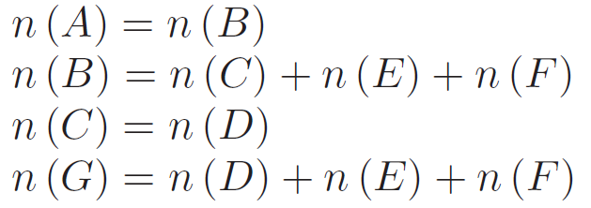
Invariants Mining
Main process:
Build event count matrix
Estimate the invariant space (r invariants) using SVD
Search invariants with a brute force algorithm
Validate the mined invariants until r invariants are obtained

Slide 27
Outline
Background & Motivation
Framework
Supervised Anomaly Detection
Unsupervised Anomaly Detection
Evaluation
Conclusion

Slide 28
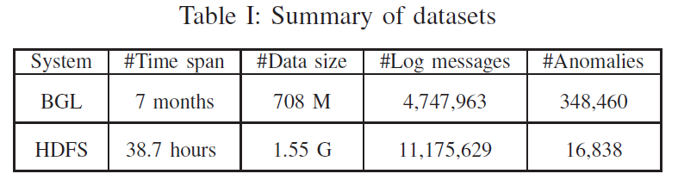
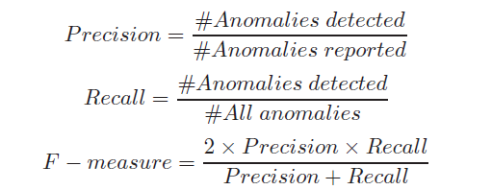
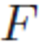
Evaluation
Data sets
Fixed windows & Sliding windows
Session windows
Performance metric
Notes:
Labels are given for each block, thus we can only use the session window to extract features.

Slide 29
Evaluation
Q1: What is the accuracy of supervised anomaly detection?
Q2: What is the accuracy of unsupervised anomaly detection?
Q3: What is the efficiency of these anomaly detection?

Slide 30
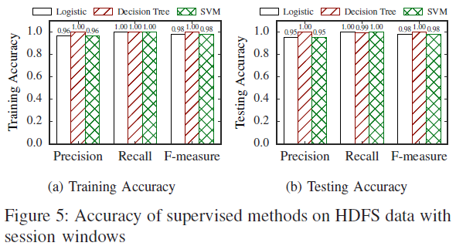
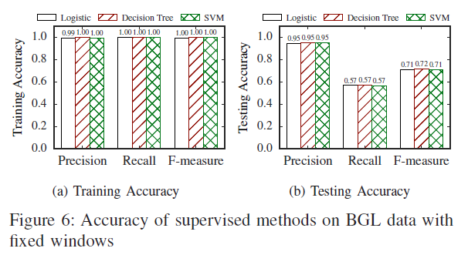
Evaluation
1. Accuracy of Supervised Methods
More sensitive
Finding 1: Supervised anomaly detection achieves high precision, while recall varies.

Slide 31
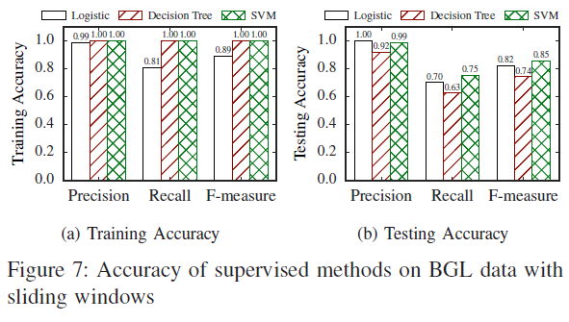
Evaluation
1. Accuracy of Supervised Methods
Finding 2: Sliding windows achieve higher accuracy than fixed windows

Slide 32
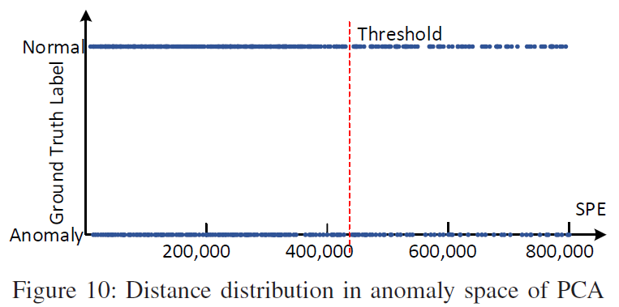
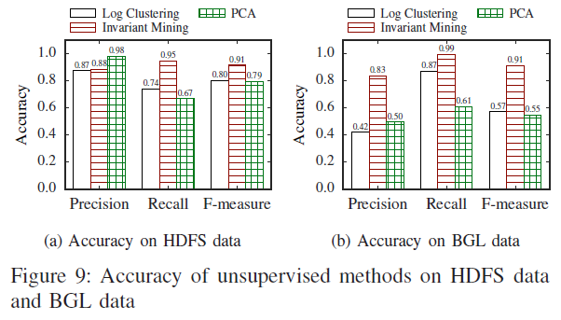
Evaluation
2. Accuracy of Unsupervised Methods
Finding 3:Unsupervised methods are not as good as supervised methods except Invariants Mining

Slide 33
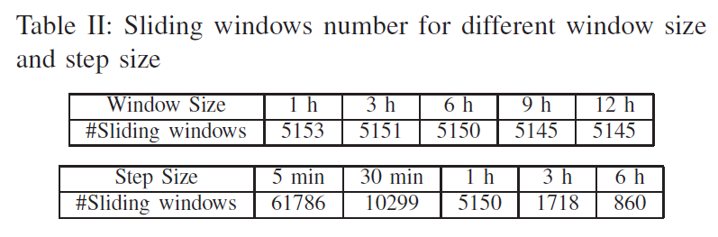
Evaluation
3. Effects of window setting on supervised & unsupervised methods

Slide 34
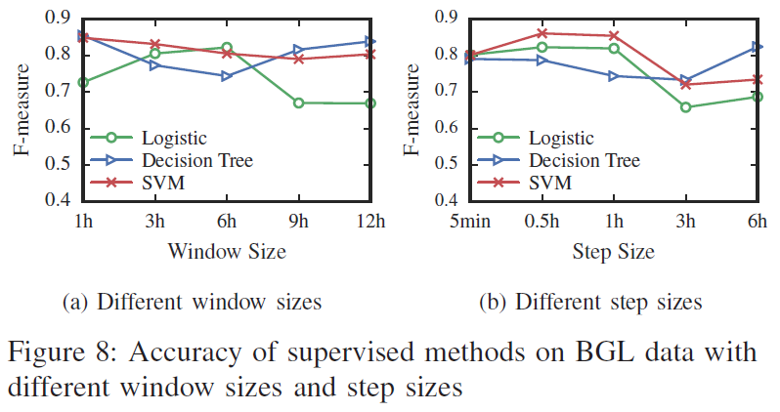
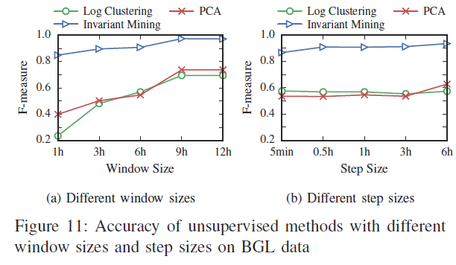
Evaluation
3. Effects of window setting on supervised & unsupervised methods
Finding 4:Different window sizes and step sizes affect the methods differently.

Slide 35
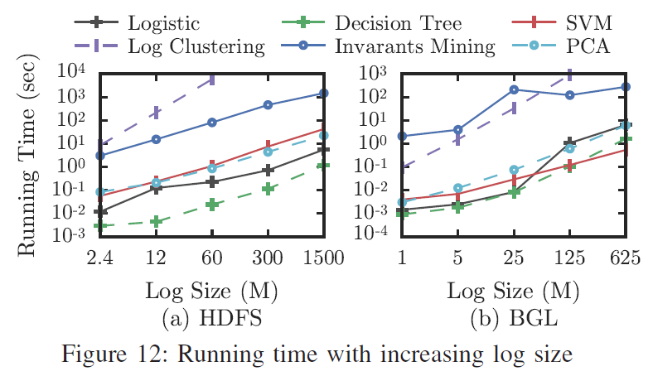
Evaluation
4. Efficiency of Anomaly Detection Methods
Finding 5: Most anomaly detection scale linearly with log size except Log Clustering and Invariants Mining.

Slide 36
Outline
Background & Motivation
Framework
Supervised Anomaly Detection
Unsupervised Anomaly Detection
Evaluation
Conclusion

Slide 37
Conclusion
In this paper, we
fill the gap by providing a detailed review and evaluation of six state-of-the-art anomaly detection methods. (over 4000 lines of Python codes)
compare their accuracy and efficiency on two representative production log datasets.
release an open-source toolkit of these anomaly detection methods for easy reuse and further study.

Slide 38
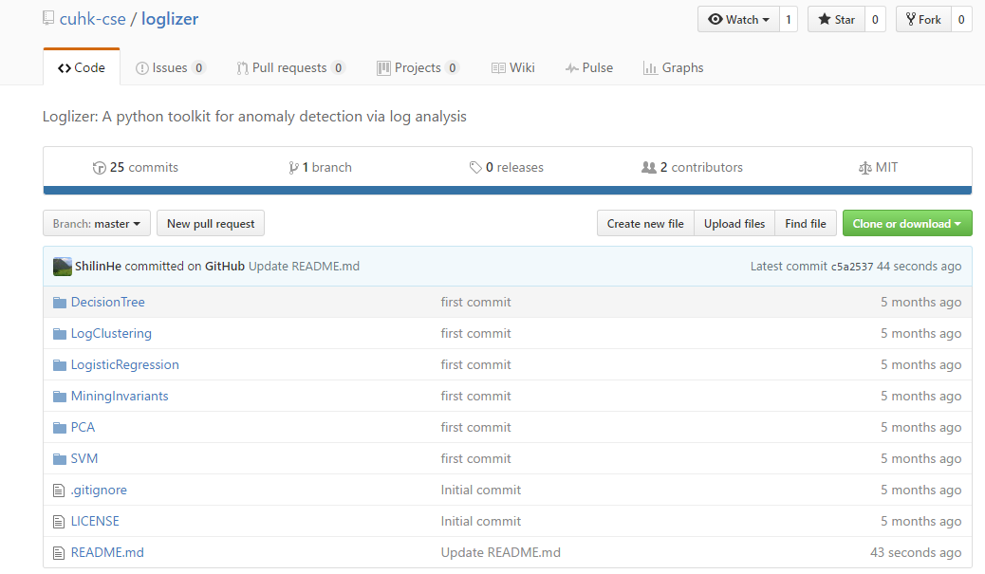
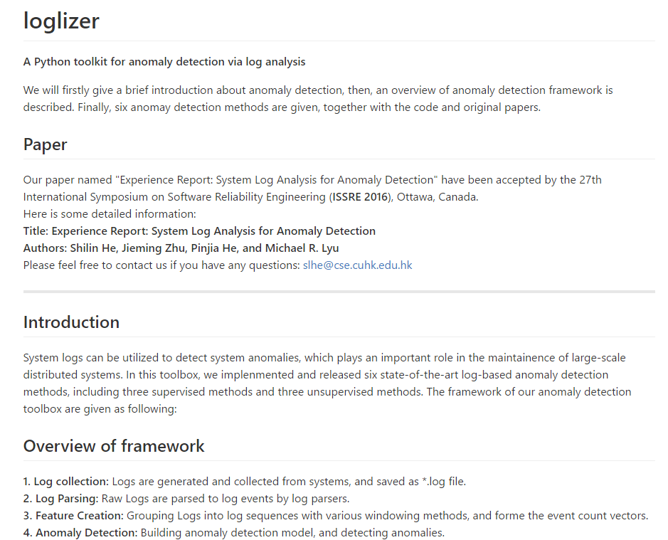


Demo
https://github.com/cuhk-cse/loglizer

Slide 39

Thanks! Q & A

